Slide 1


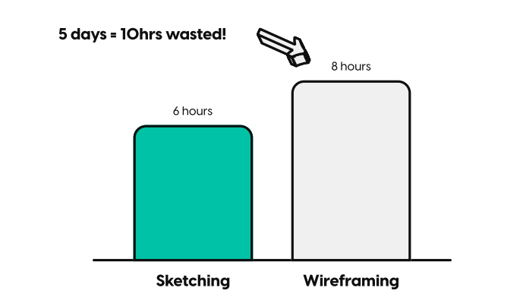
BEFORE SESSION
Sketching
10 MIN
Watch the video -
Answer the following questions::
Difference between sketching and wireframing?
Why should we use sketches before going to wireframes on Figma?
https://www.youtube.com/watch?v=eT-m_XJN0FU

Slide 2
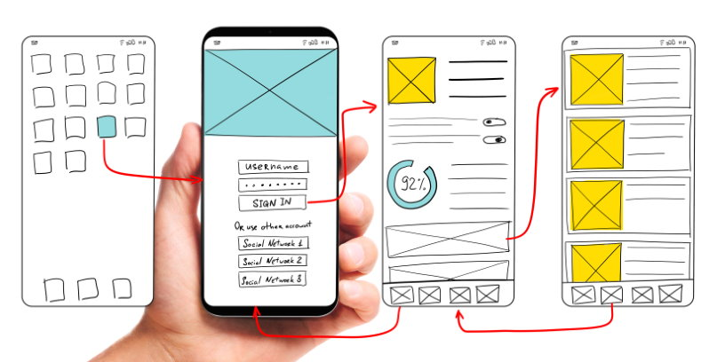
BEFORE SESSION
User Flow
10 MIN
Watch https://www.youtube.com/watch?v=KYLvmxcWcEA
Answer the following questions::
What are the 2 kind of user flows?
Complete this sentence:
User flow are created to show how a ___ complete a _____ from ____ to the ____

Slide 3
BEFORE SESSION
User Flow
10 MIN
Watch https://www.youtube.com/watch?v=KYLvmxcWcEA
Answer the following questions::
What are the 2 kind of user flows? BASIC or VISUAL user flow
Complete this sentence:
User flow are created to show how a USER complete a TASK from BEGINING to the END

Slide 4

UX Design
DAY 2

Slide 5
UX Course Agenda
DAY 1
DAY 2
0 Introduction On UX Design
1 Framing the problem
2 User interviews
3 Analyzing the competition
Sketching
User flows
Usability principles

Slide 6


UX Workshop plan
Focus on a specific user story (complex enough) from your project
Draw on paper the different views on paper the suer will visit to perform his/her need
User flow : Arrange your mock up son flip chart and add transition rules
1 HOUR
1 HOUR
1 HOUR
NEW VERSION
BREAK
BREAK
BREAK
Mock-up
on paper
User Flow
Flipchart
Some group
present
Feedbacks
Usability
Principles
Mock-up
on paper
User Flow
Flipchart

Slide 7
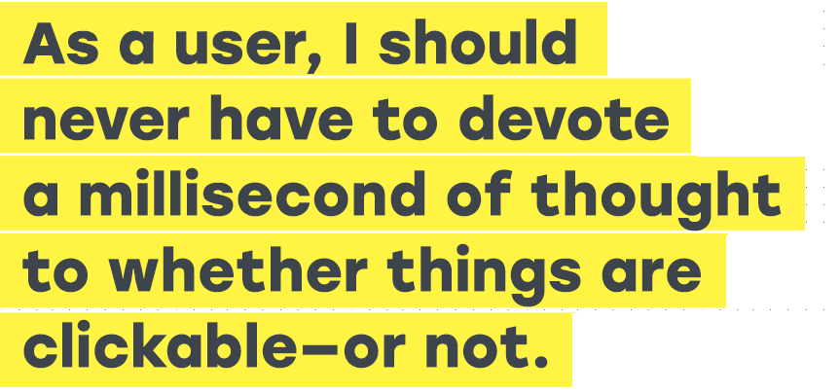
DON’T MAKE ME THINK !!

Slide 8
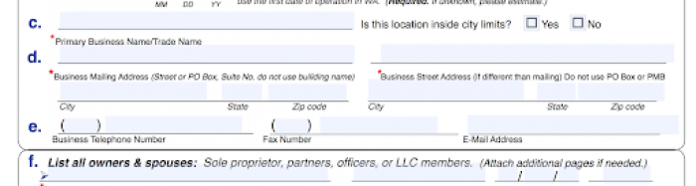
Which field should I use to enter my business street address?
g
h
G ?
H ?

Slide 9
Which field should I use to enter my business street address?
g
h
G ?
H ?
It s unclear !

Slide 10
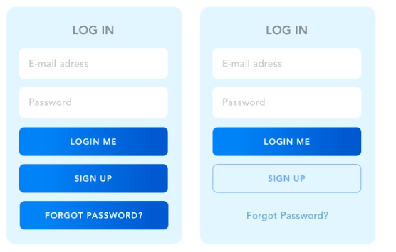
I want to login, which UI make me think the most?
A
B

Slide 11
I want to login, which UI make me think the most?
There s no on call button
Lack of hierarchy of the actions
A
B

Slide 12
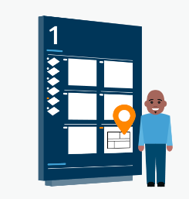
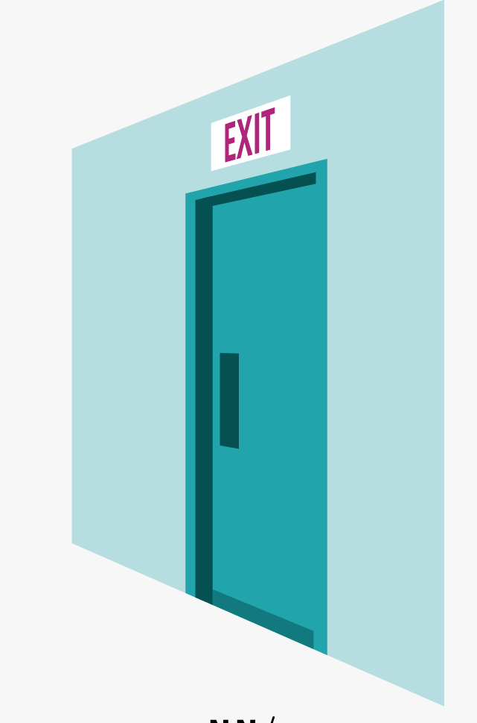
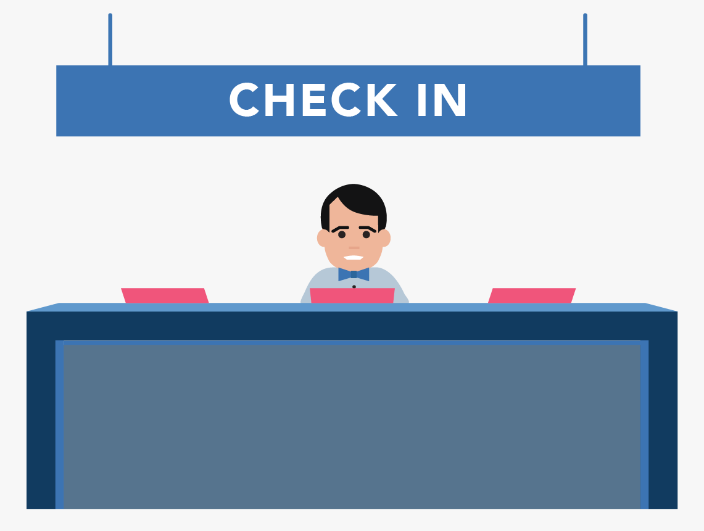

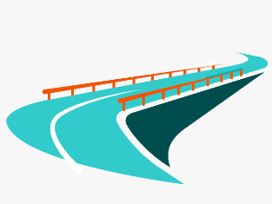
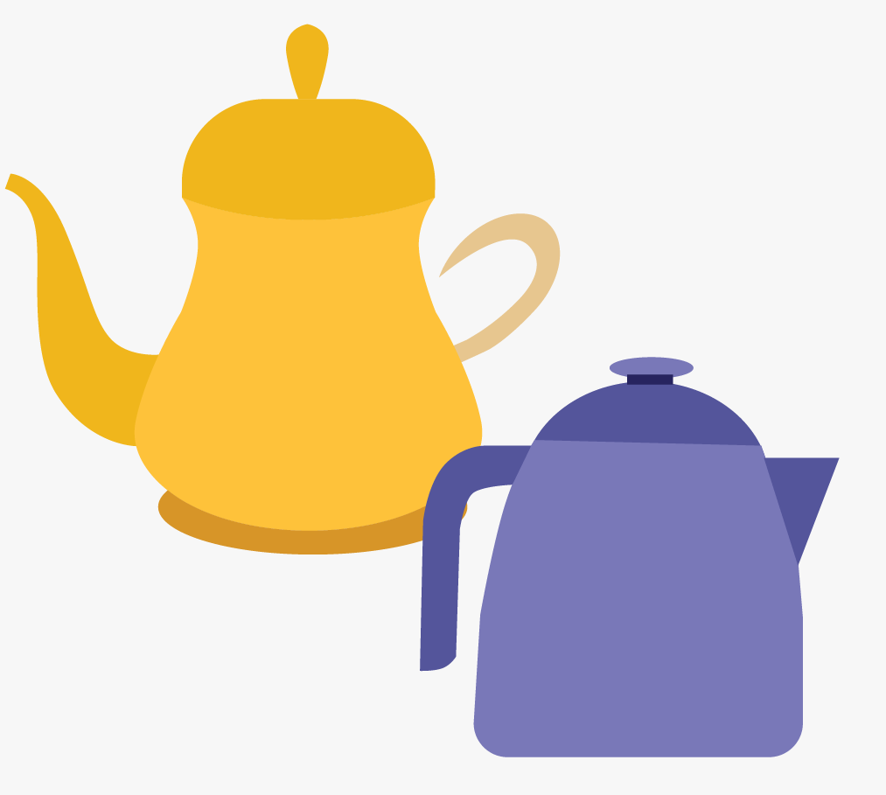
Usability Principles Criteria
Visibility of system status
User control and freedom
Consistency
and standards
Navigability
Error prevention
Minimalist design

Slide 13
Visibility of system status
The system should always keep users informed about what is going on

Slide 14
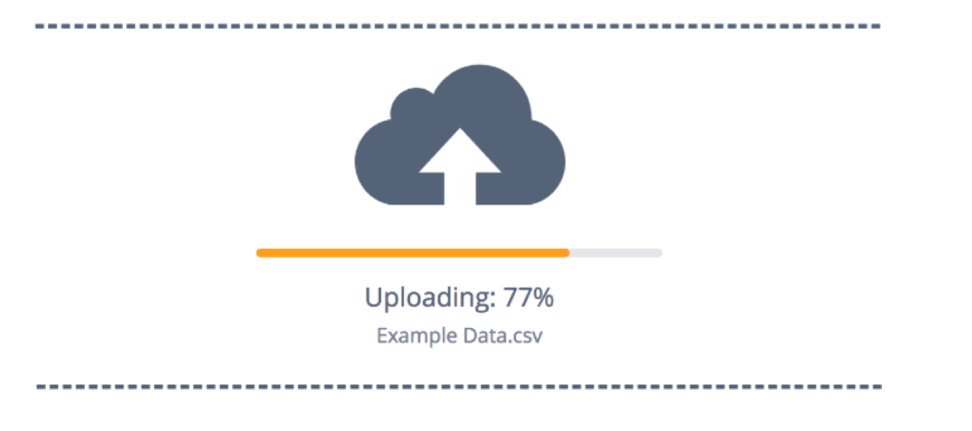
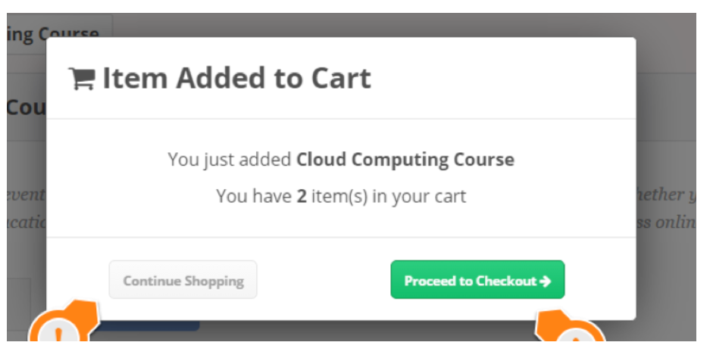
Visibility of system status
Information on evolution
Notifications
Feedbacks after each action

Slide 15
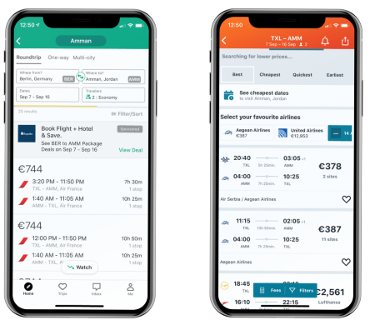
Which app is better to inform about the loading, and why ?
1
2

Slide 16
Which app is better to inform about the loading, and why ?
The loading progression can be estimated
1
2

Slide 17
User control and freedom
Users often perform actions by mistake. They need a clearly marked "emergency exit" to leave the unwanted action

Slide 18

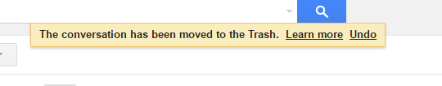
User control and freedom
Backward steps are possible

Slide 19
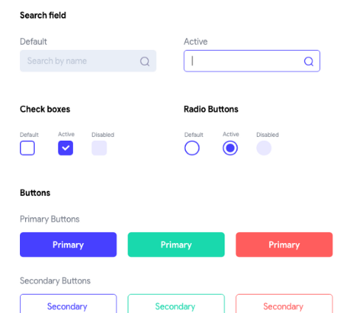
Consistency & standards
Users should not have to wonder whether different words, situations, or actions mean the same thing. .

Slide 20
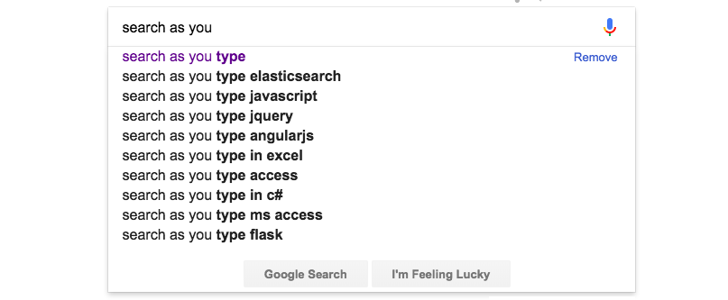
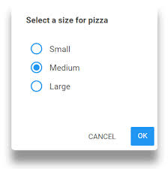
Error prevention
Even better than good error messages is a careful design which prevents a problem from occurring in the first place

Slide 21
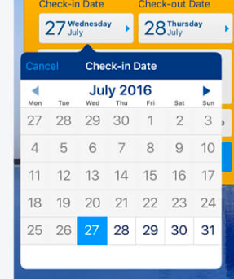
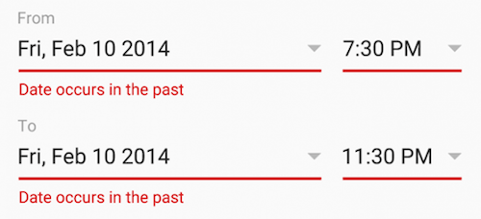
Which app is better to prevent error when selecting dates ??
1
2

Slide 22
Which app is better to prevent error when selecting dates ??
No error possible
1
2

Slide 23
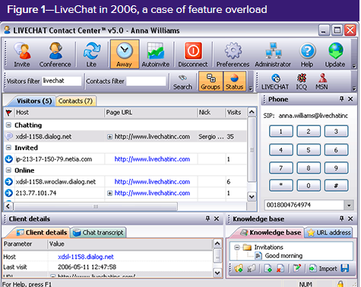
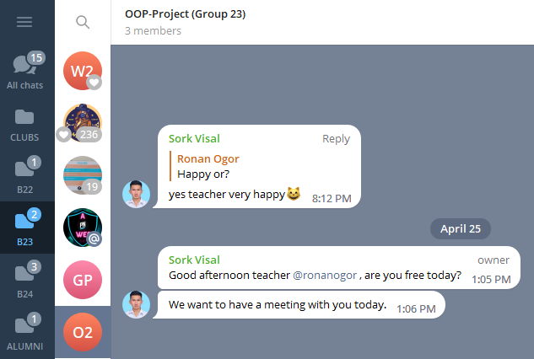
Aesthetic and minimalist design
Interfaces should not contain information that is irrelevant or rarely needed

Slide 24
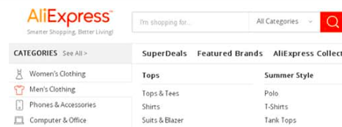
Navigability
You should always know where you are, how to come back , and where to go

Slide 25
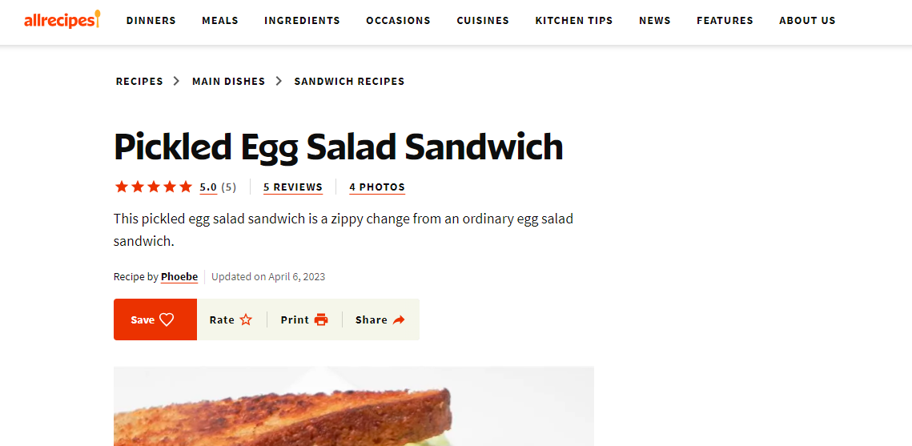
Navigability
Where am I ?
What is this page exactly about
How can I go back to the list of sandwiches recipes?
How can I go back to he home page?

Slide 26
UX Workshop plan
From what we learnt, re-think your approach
Produce a new version of your user flow and sketches
1 HOUR
1 HOUR
1 HOUR
NEW VERSION
BREAK
BREAK
BREAK
Mock-up
on paper
User Flow
Flipchart
Some group
present
Feedbacks
Usability
Principles
Mock-up
on paper
User Flow
Flipchart

